Slide 1
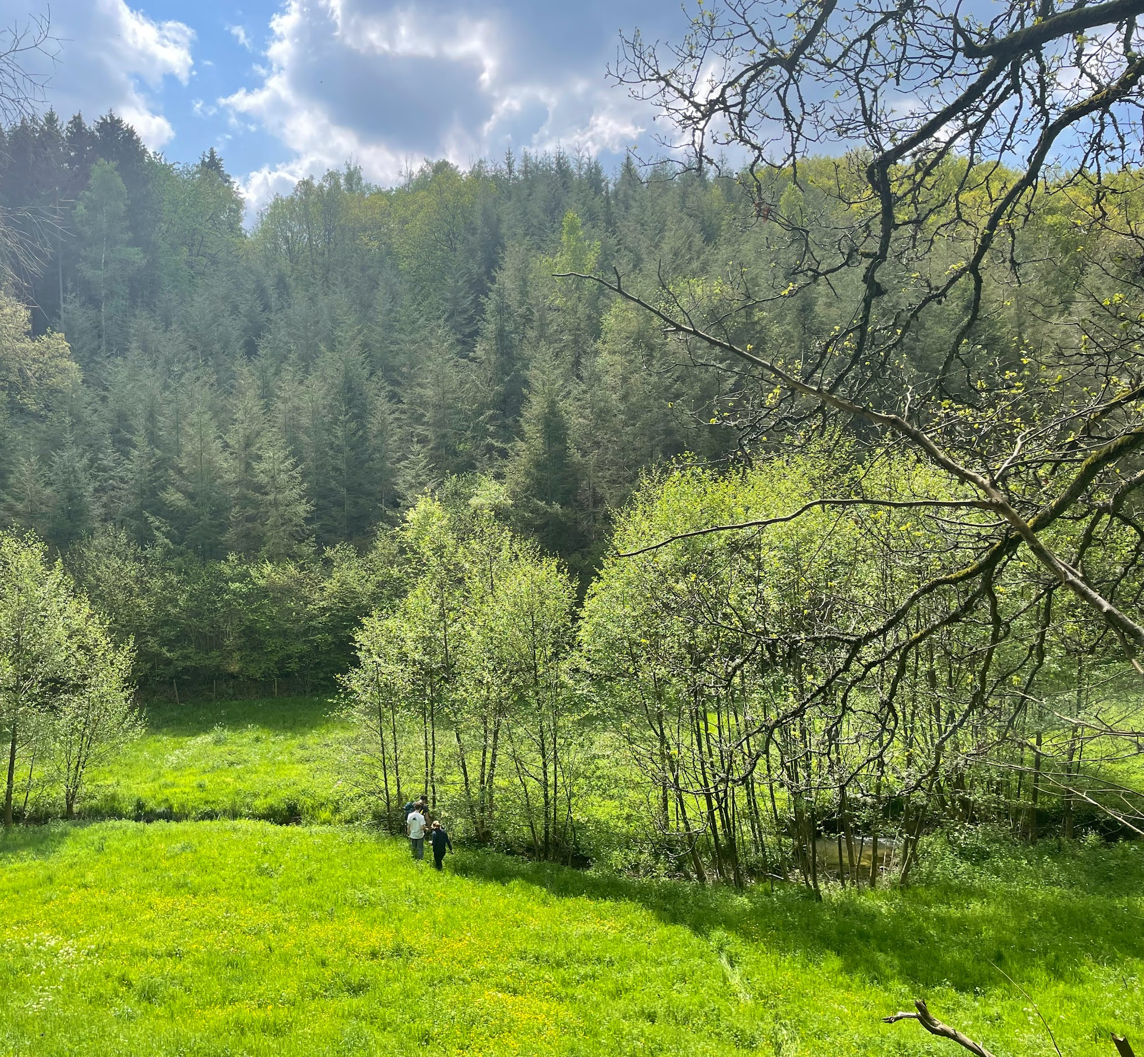
Comparing stream flow contribution to land use & topography
Karen Chen
David Haasnoot
Emma Oosterveld
Jesse van Leeuwen
Sophie van Velzen

Slide 2
Goal & main question
Goal: find the relationship between topographical information (and land use) and the discharge of different tributaries
Hypothesis
Topography and land use provide information on storage
More storage means higher base flow
High TWI → more discharge
High vegetation → more discharge
19-06-2023
Notes:
The goal of the hydrology tracer experiment was to find the relationship between topographical information (and land use) and the discharge of different tributaries within the Mechelbach catchment.
The hypothesis is that both topography and land-use provide information on storage and flow paths of water in the area. Areas with a large storage capacity will store rainwater and distribute it to streams over a longer stretch of time. Given that the weather conditions imply that most of the observed stream flow will come from storage, baseflow conditions, we expect to see a positive relationship between TWI and discharge. Similarly, we expect areas with high vegetation cover to generate more baseflow than areas that promote runoff, given their role in slowing down runoff and allowing it to percolate in the soil.

Slide 3
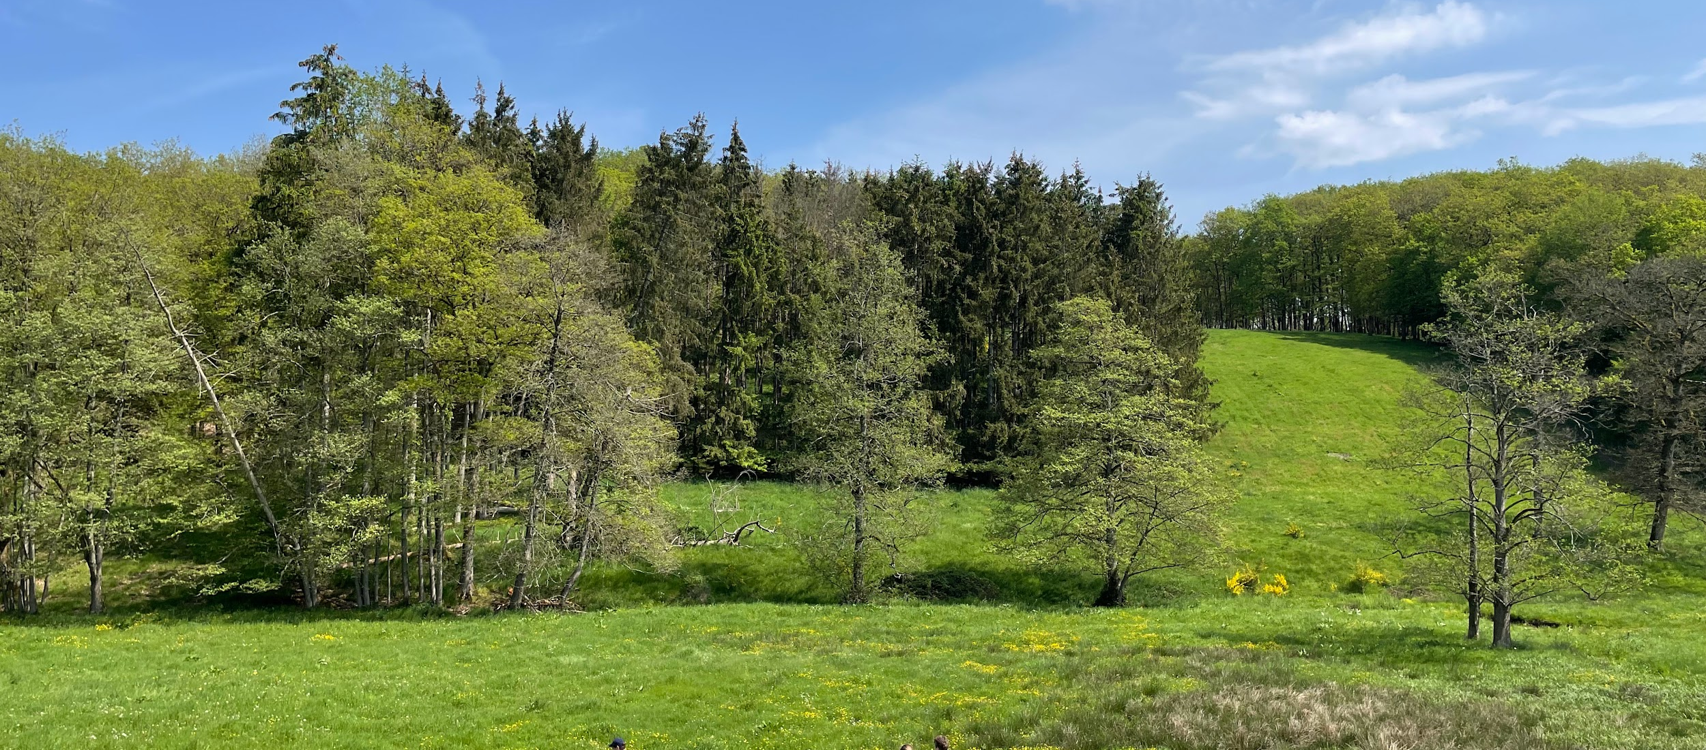
Method
Notes:
The field measurements were obtained by measuring EC and discharge in the Mechelbach catchment. Since we all have done that, no further explanations will be given today.

Slide 4
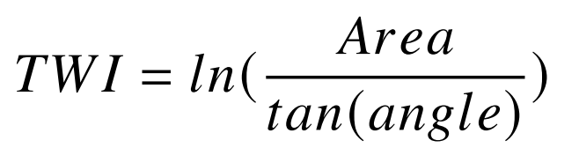
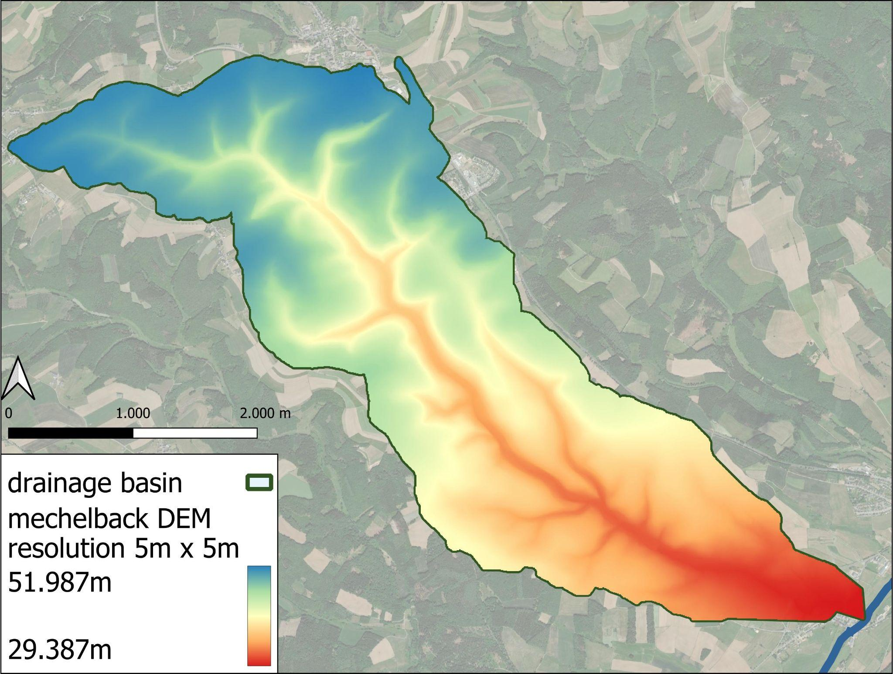
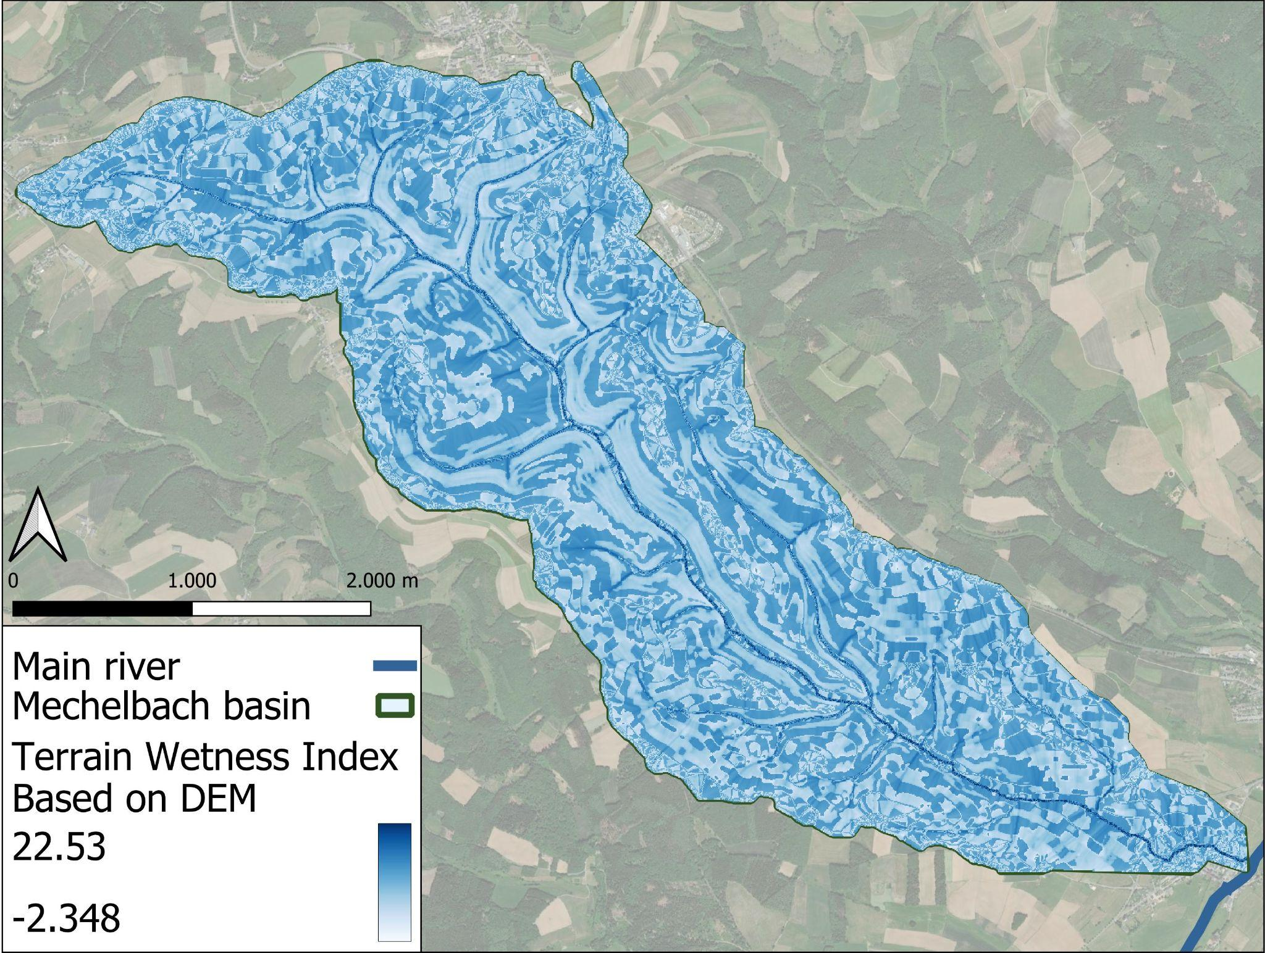
DEM & TWI
Notes:
Topographical information was obtained through GIS analysis. First, a digital elevation model was used to generate stream flow based on the topographical information. The rivers are labelled using Strahler order to indicate their sizes.
The Topographical Wetness Index (TWI) described a measure of storage. From the DEM the upstream area and slope angle can be calculated for every pixel. TWI is calculated through the equation given above. In theory, the higher the TWI, the more storage an area can provide, resulting in higher base flow.

Slide 5
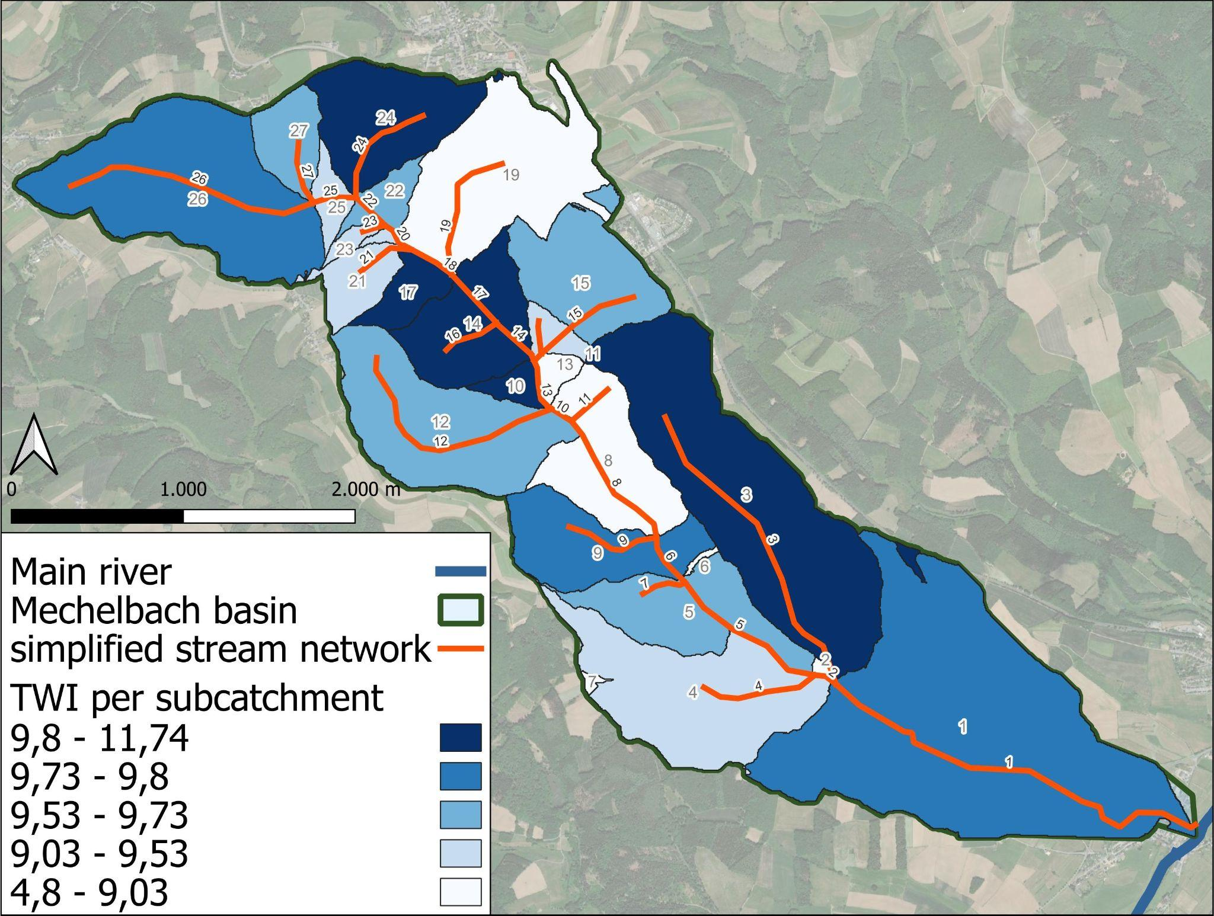
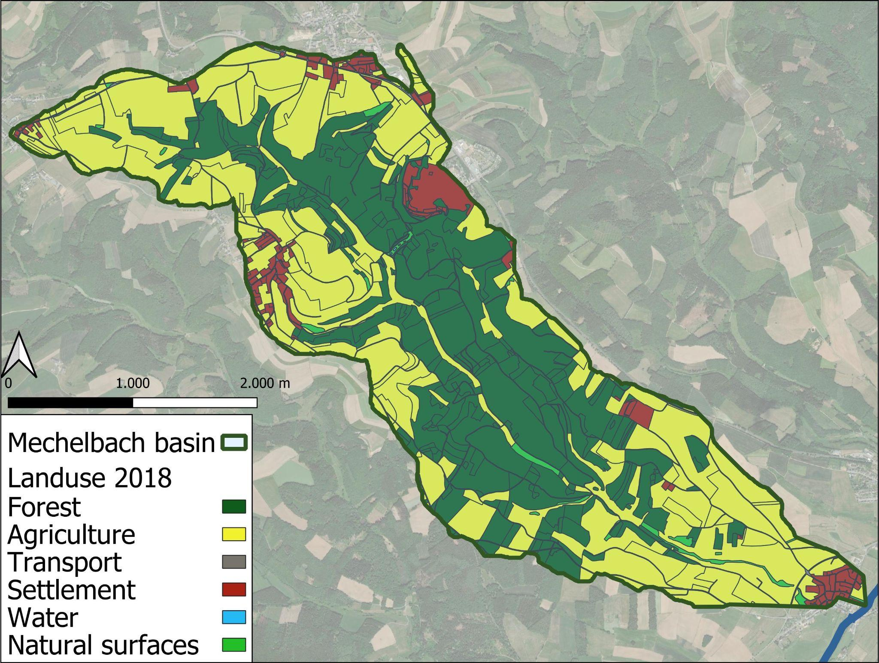
TWI & land use
Notes:
To be able to compare TWI with the observed field measurements, the catchment was divided into sub-catchments. For each sub-catchment, the TWI for the total upstream area was calculated.
A land use map is required to compare the correlation between different land use types and discharge of different subcatchments. Three types of land use are indicated: settlements, agriculture and forest.

Slide 6
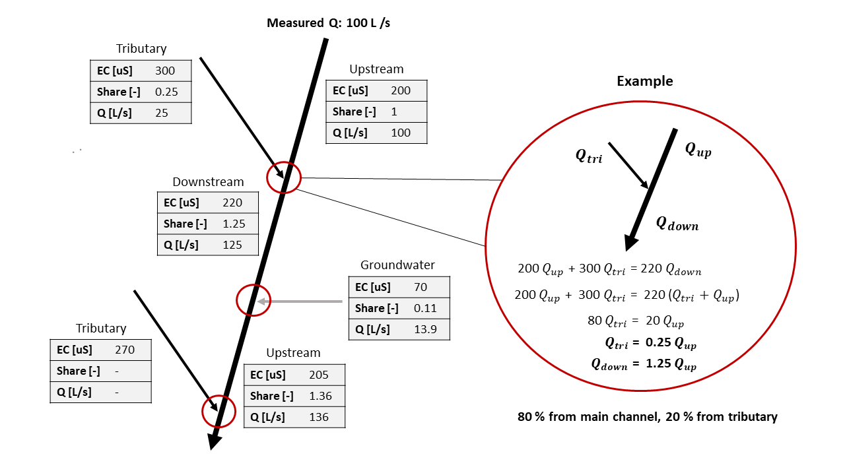
EC routing
Mixing model:
Q1 + Q2 = Q3
Q1*C1 + Q2*C2 = Q3*C3
Notes:
To calculate the contributions of different sub catchments, a mixing model was used. For each confluence, it was calculated in percentages how much of the water downstream came from the main stream and how much came from the tributary. For sections with a change in EC value with no visible tributaries, the calculation was done with groundwater as the tributary.

Slide 7
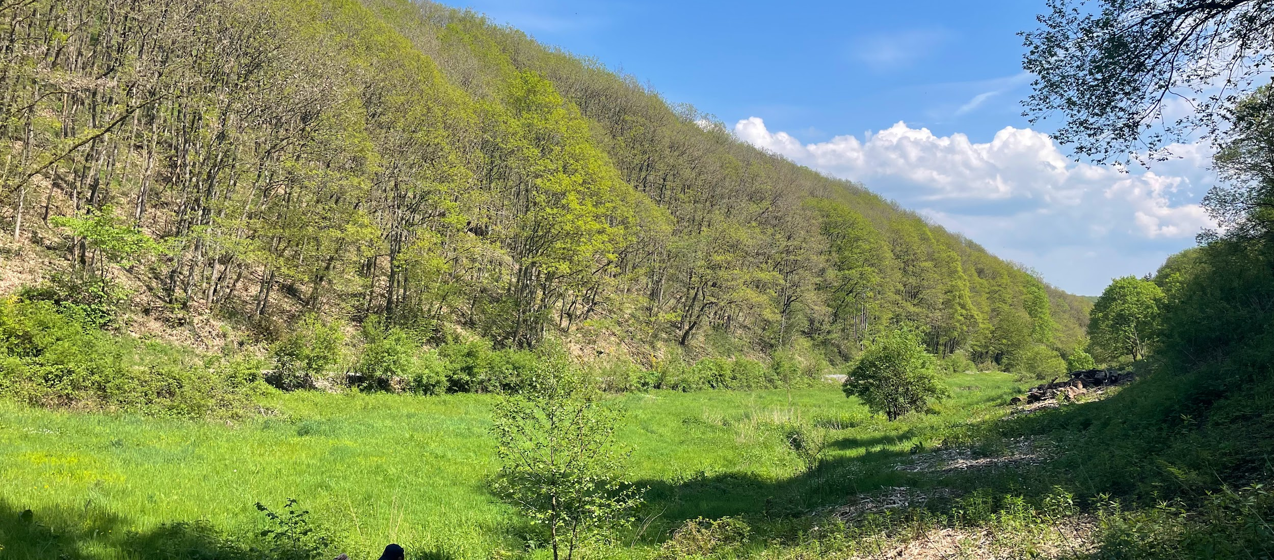
Results
Notes:
Now we will show the results

Slide 8
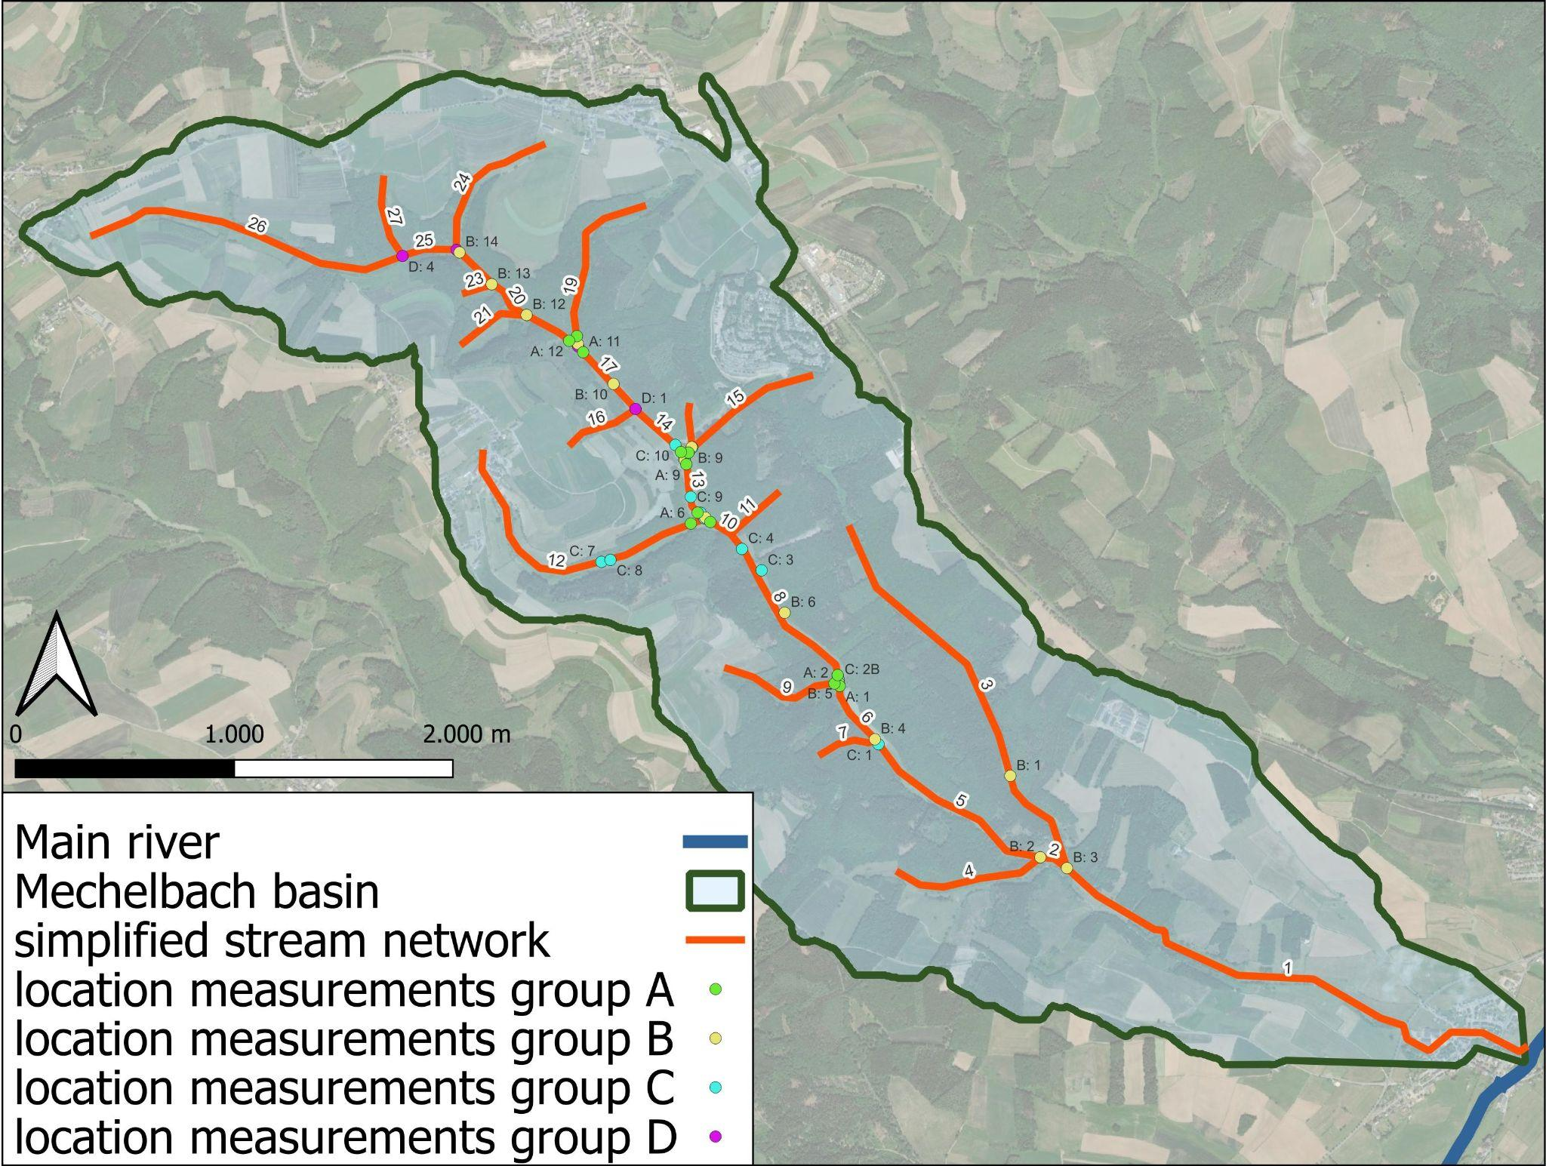
Notes:
All the groups measured discharge and EC in different parts of the Mechelbach catchment. All the locations are indicated on this map, numbered from downstream to upstream.

Slide 9
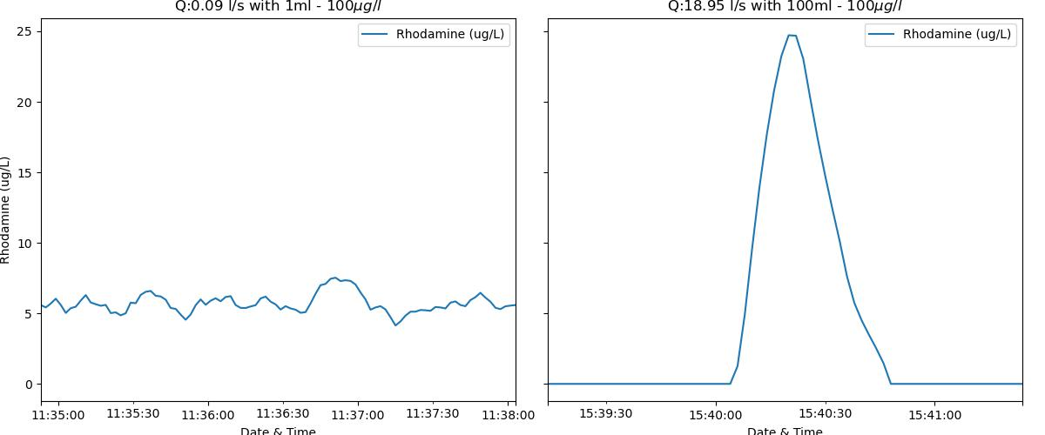
Results - Discharge measurements
Notes:
The amount of rhodamine solution that was used in the first experiments was 1 mL of 100 microgram/L. This concentration was too low and did not give any useful results, as can be seen in the left plot. After a few more tries, up to 100 mL of the same concentration gave good results, as can be seen in the right plot. With a curve like this, discharge can be calculated.

Slide 10
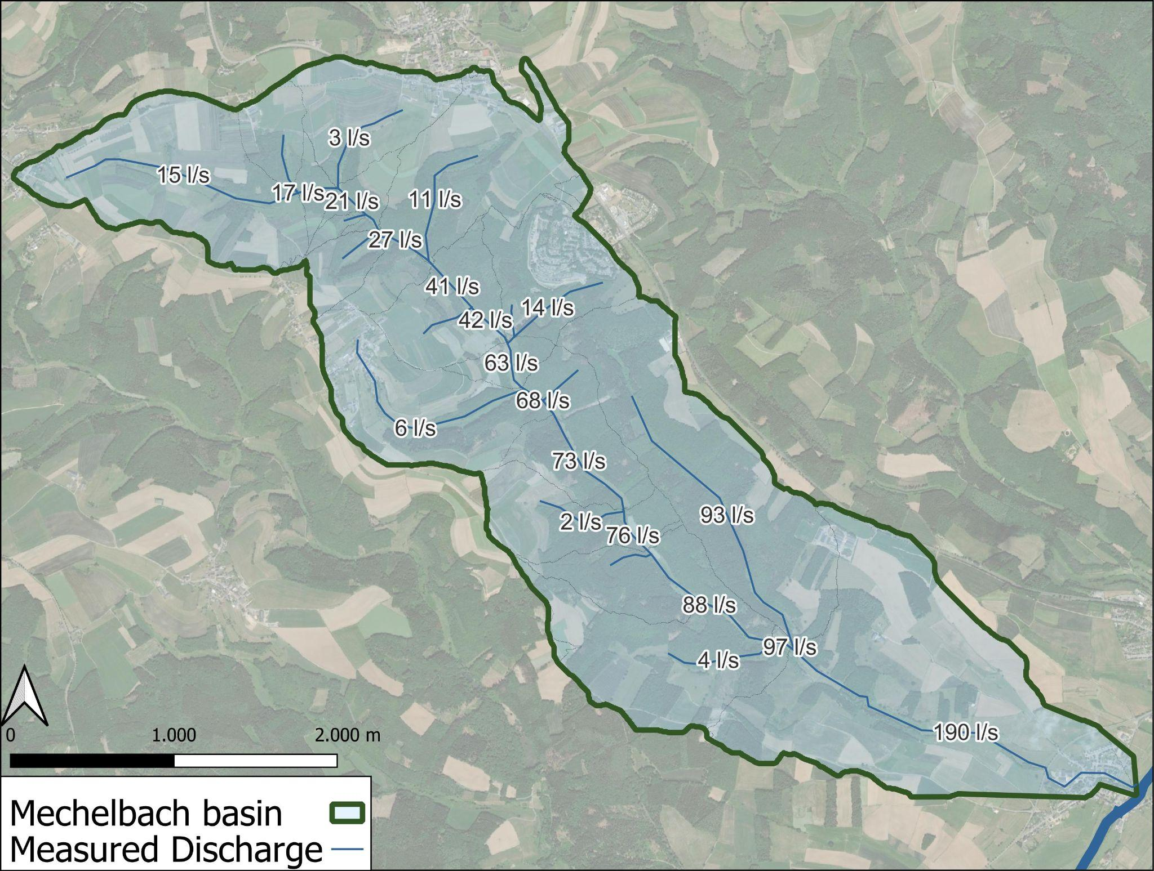
Results - EC routing
Notes:
The EC routing was done using a starting value of 190 l/s downstream (which was calculated by using one of the values from the measurements obtained with rhodamine). For most of the confluences, the distribution is as follows: around 85 to 100 percent of the discharge comes from the main stream and and around 0 to 15 percent comes from the tributary (or groundwater). This makes sense because tributaries usually have a smaller stream flow than the main stream.

Slide 11
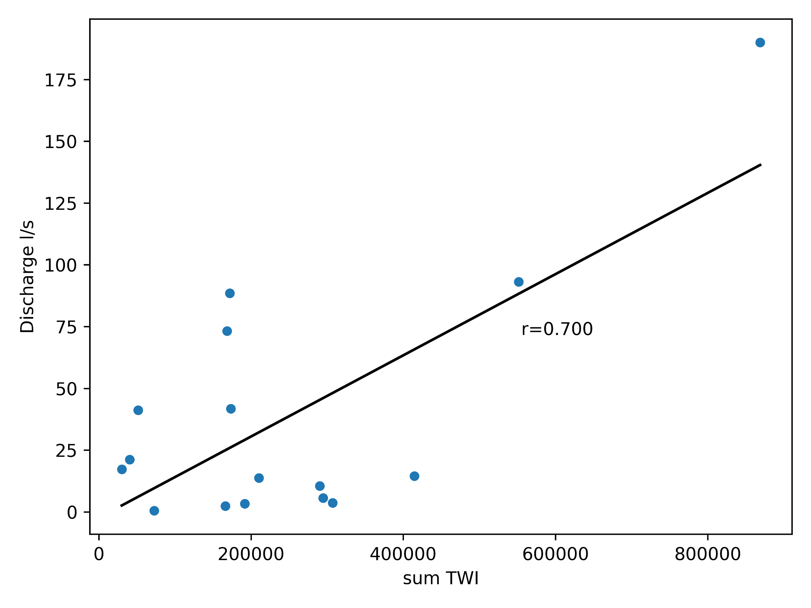
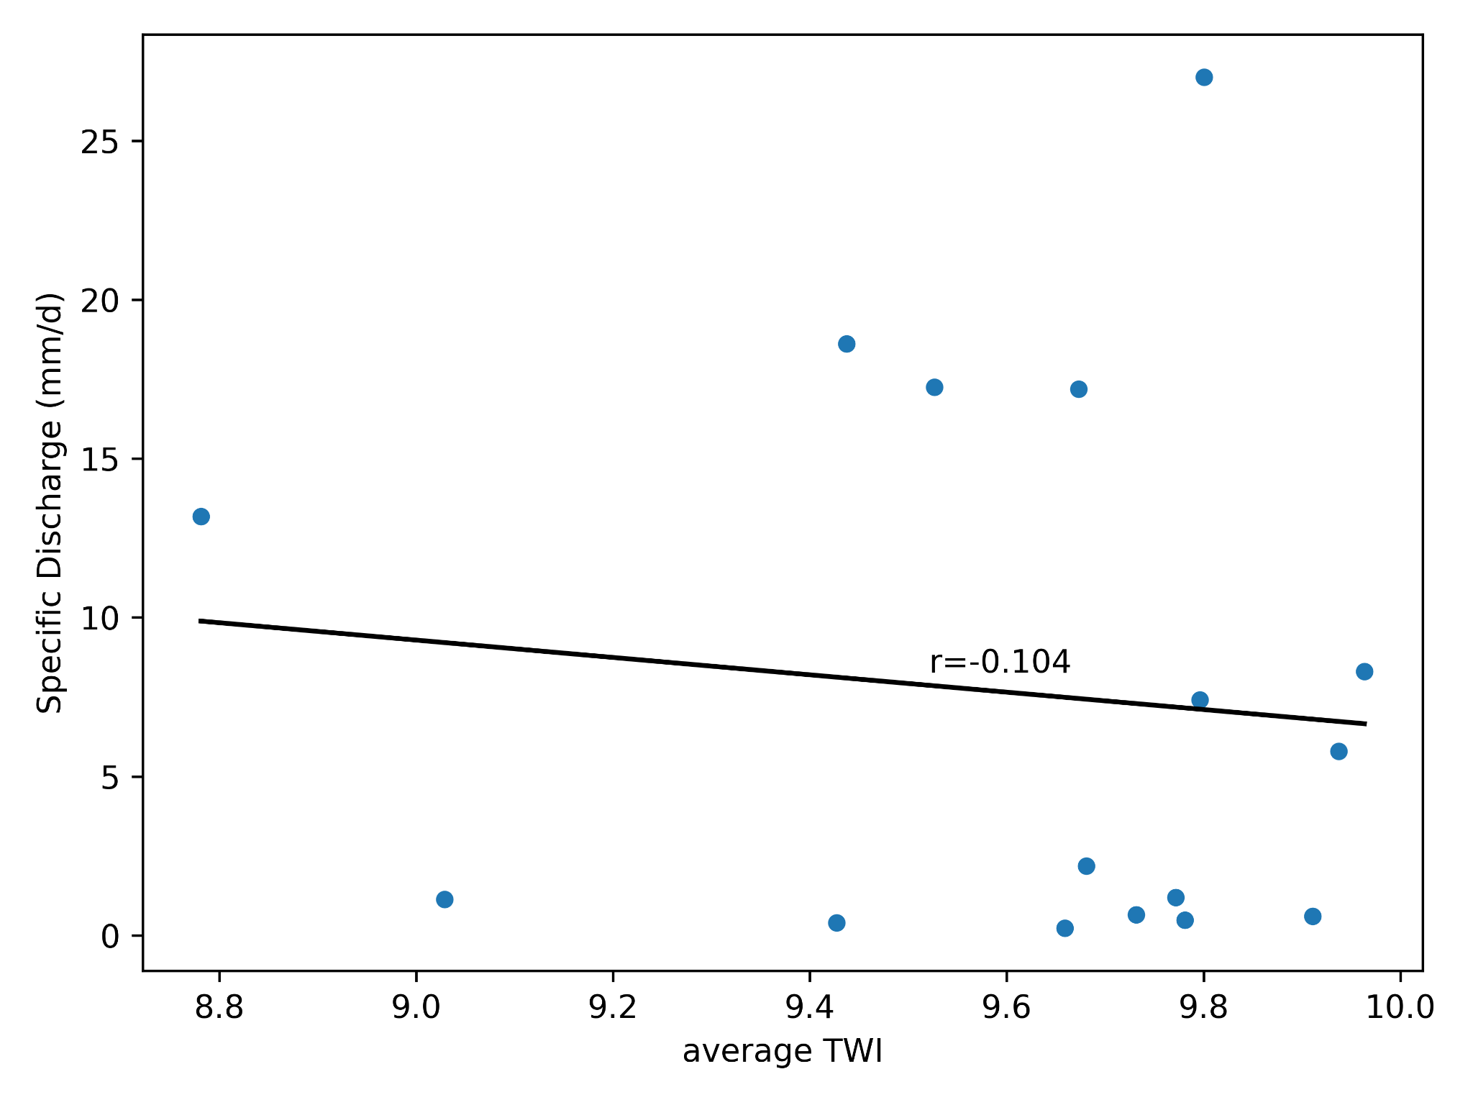
Results - TWI
Notes:
We compared discharge with the summed TWI and specific discharge with average TWI. Both show a large spread in results, but the observed trend is different: for average TWI it seems like there is no clear relation, while summed TWI gives a positive relation. A possible explanation for this is that an area with both very low and very high TWI shows different behaviour compared to an area with average TWI, but both areas have the same average TWI value. Because of this, the method using summed TWI seems to be a better representation of reality.

Slide 12
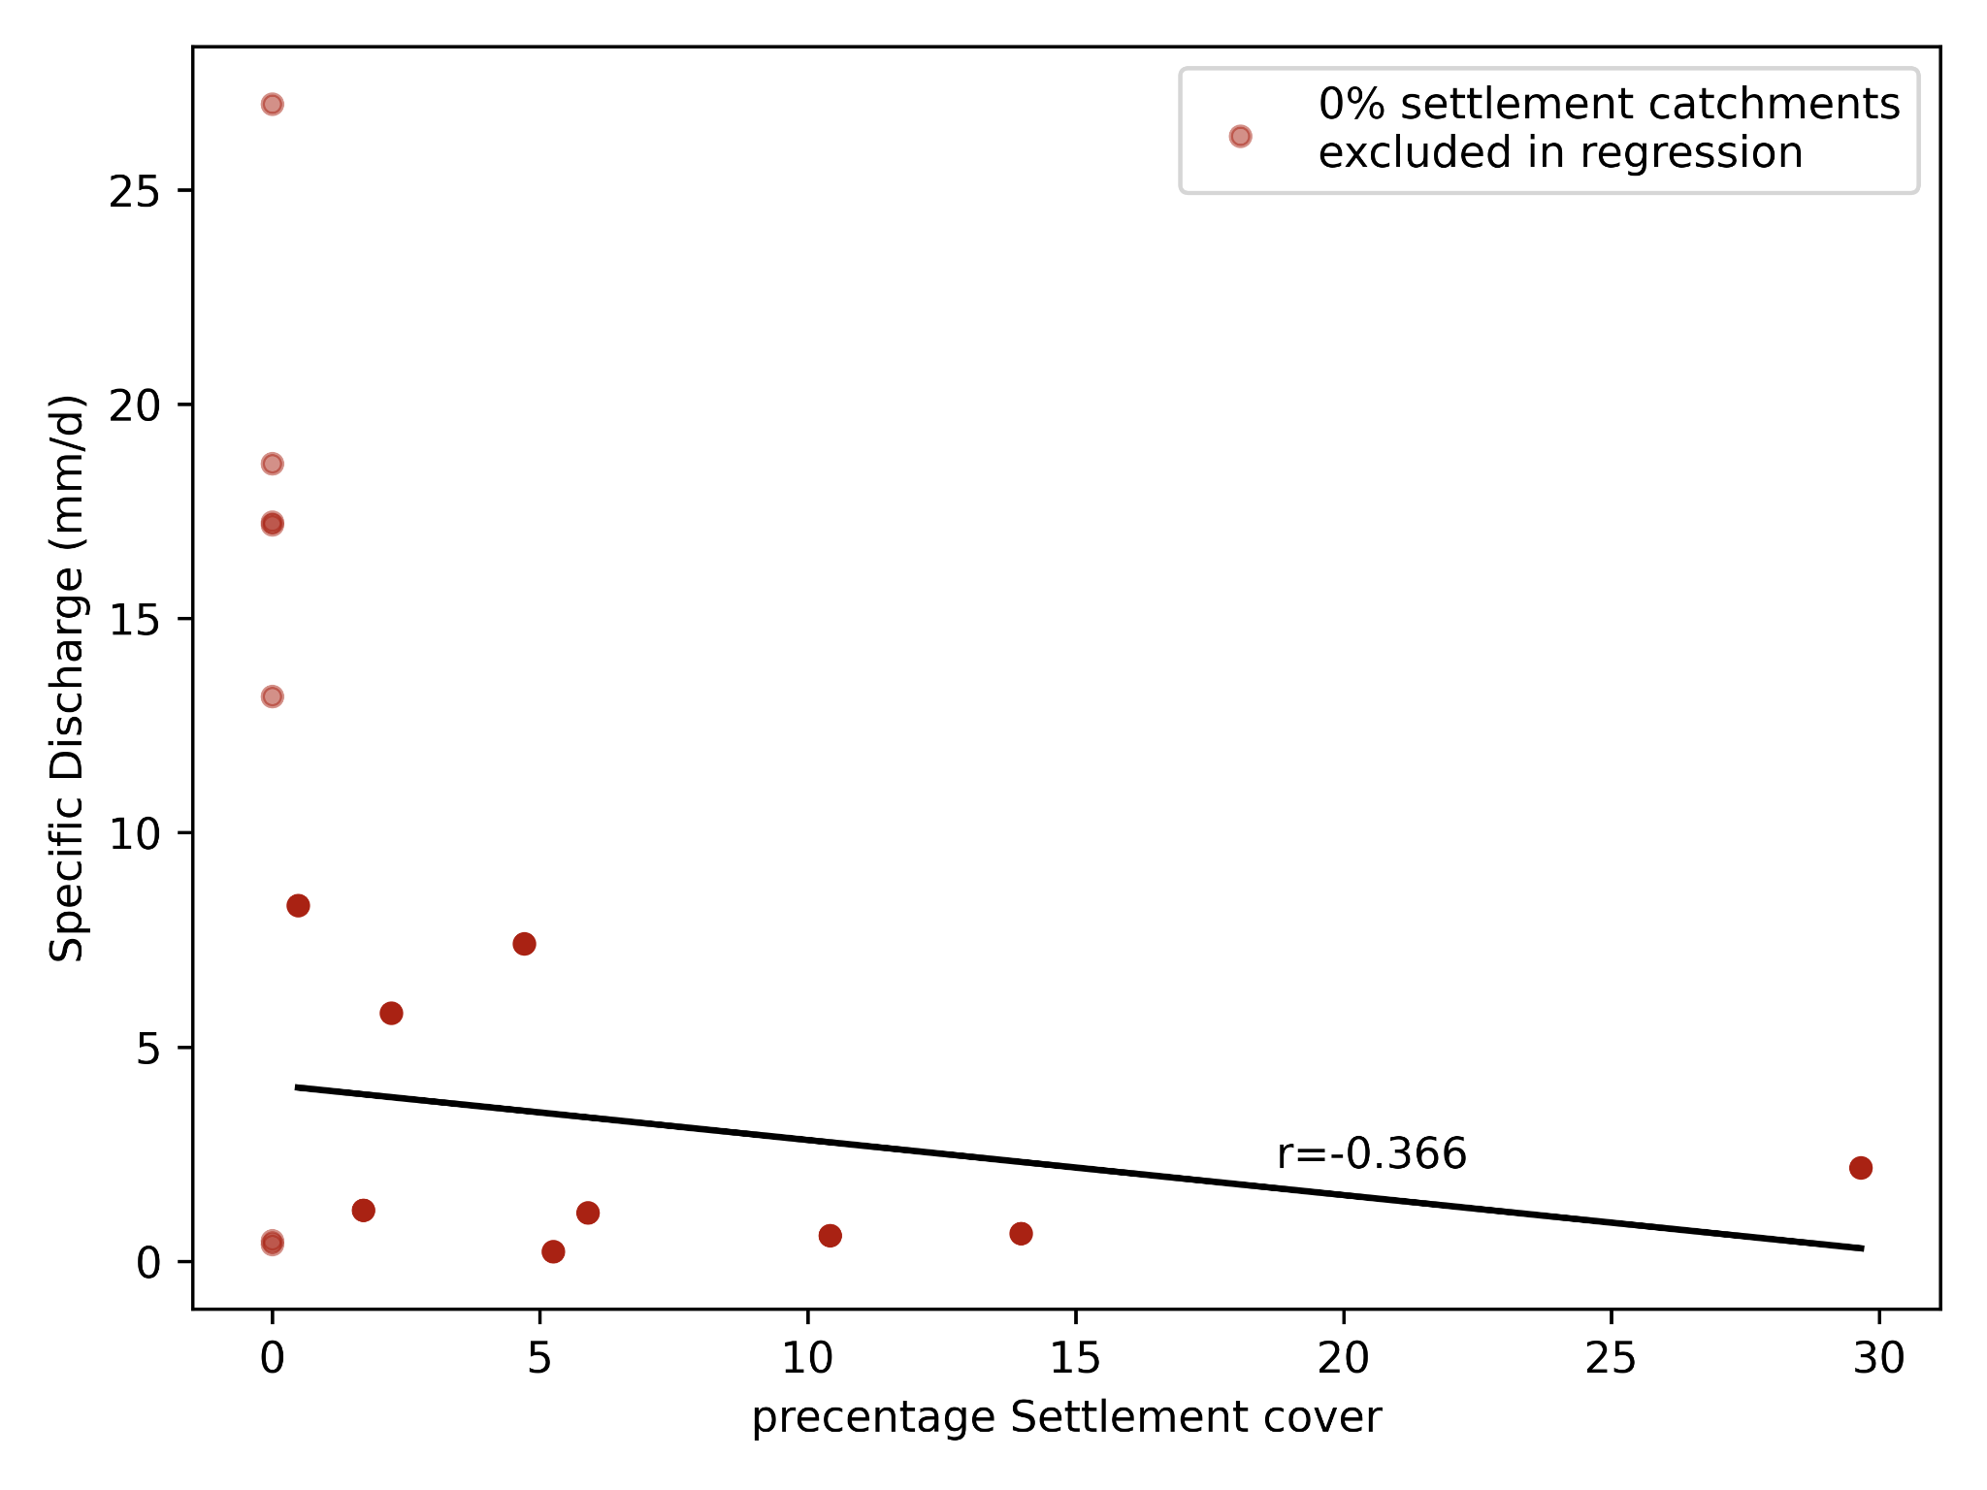
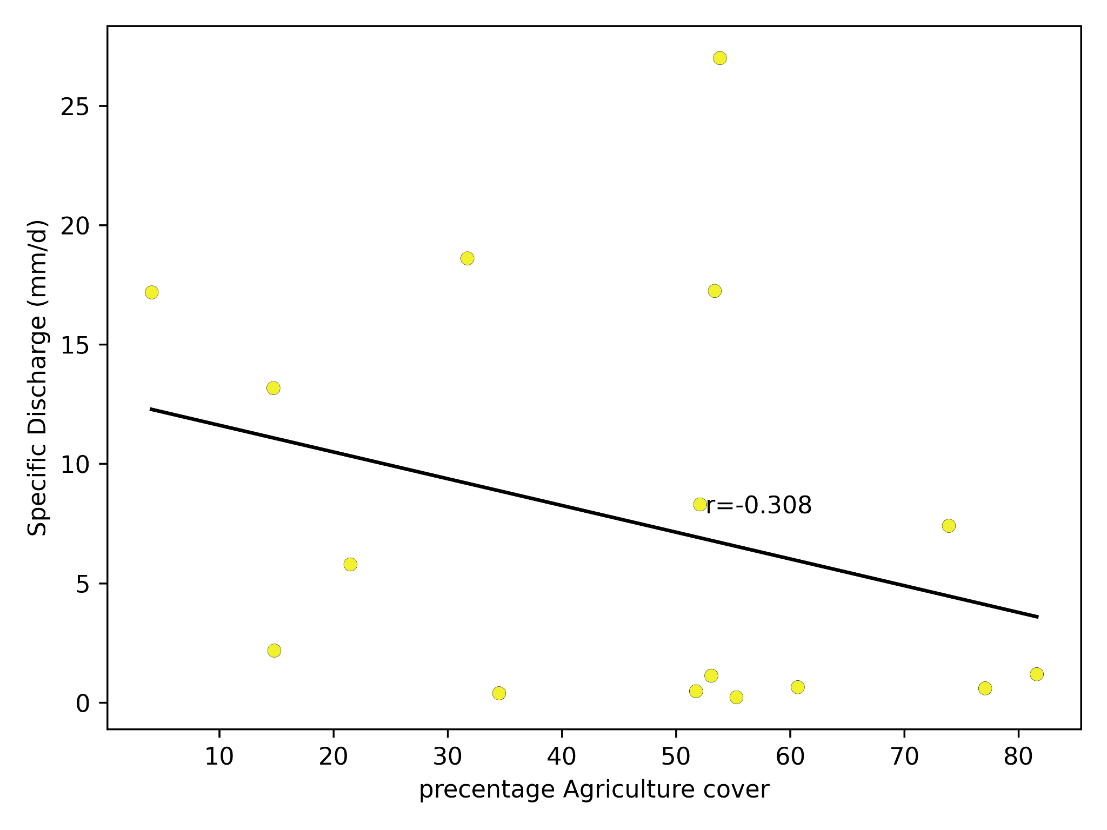
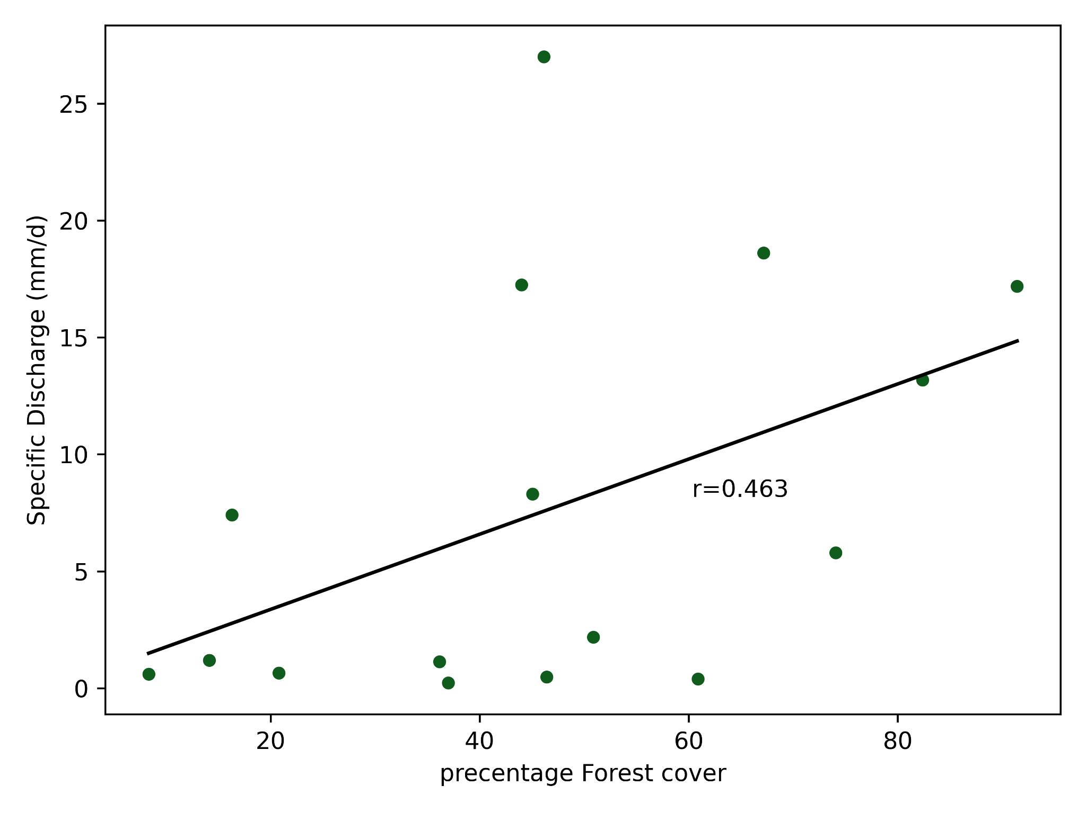
Results - Land use
Notes:
When discharge is compared to land use, it can be seen that both agriculture and settlements have a negative effect on the amount of discharge. Forests have a positive effect on the amount of discharge. This indicates that areas with relatively large forest cover have the most storage and therefore generate the most discharge.

Slide 13
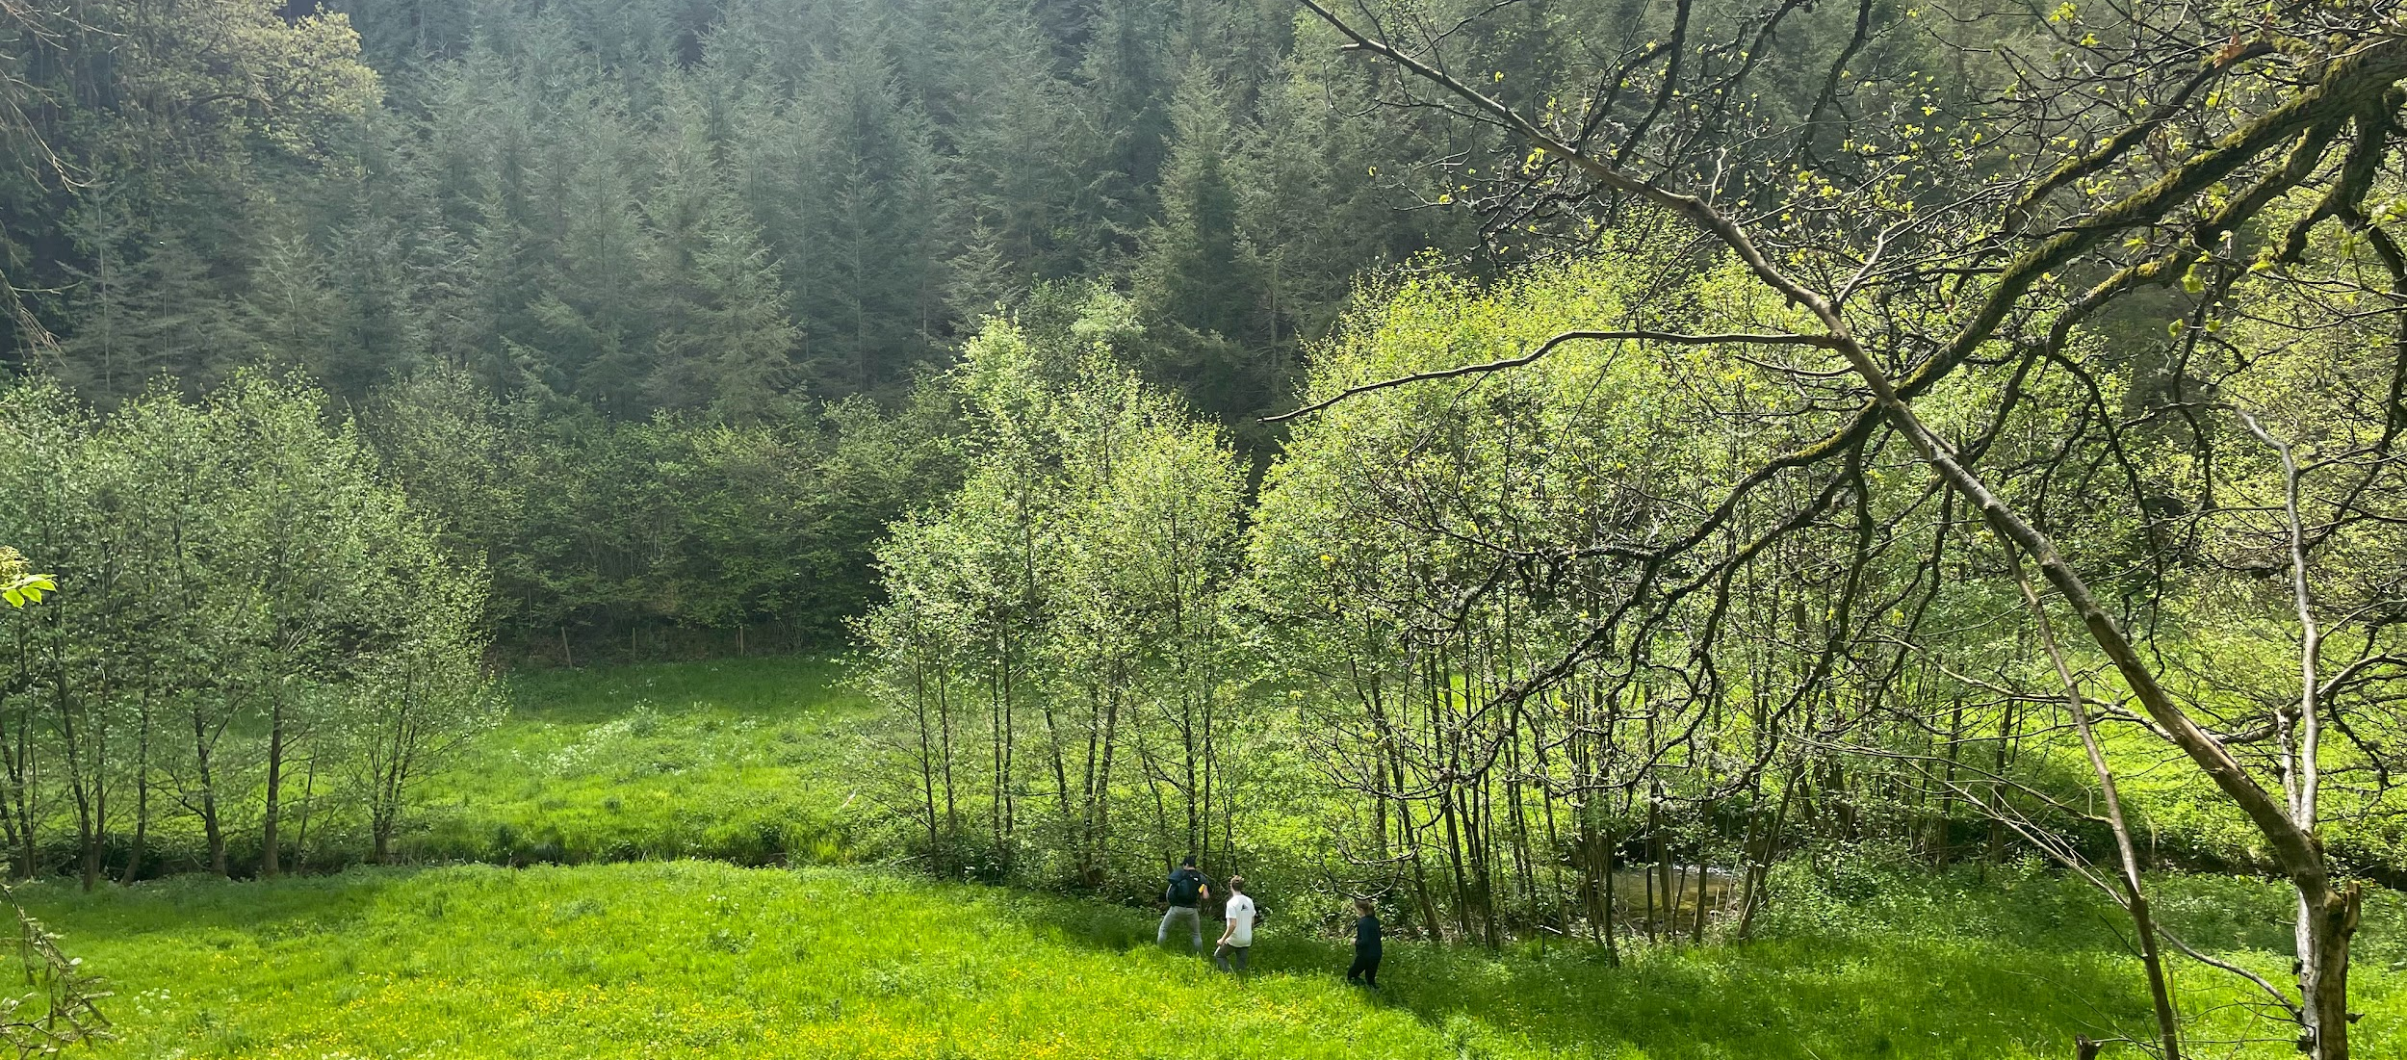
Discussion & Conclusion

Slide 14
Discussion
Quality of measurements
Good quality: EC routing
Bad quality: discharge (at the same point: 8.25 L/s on day 1, 17.38 L/s on day 2)
Causes of errors: rhodamine method, mixing, time
Recommendations: improve quality of discharge measurements
Notes:
Looking at the quality of measurements, EC routing is really good: on different days, almost the same numbers were found in the same locations. Also in places where extra high or low values were expected, this was observed in the measurements.
For the discharge, unfortunately this was not the case. Measurements were very different from each other and not consistent. For instance at one point, one group measured 8.25 L/s. The next day, another group measured 17.38 L/s at exactly the same location. This is no exception, for another location, the value of one of the measurements was also more than double the amount of the other. Some of the observed discharges were really close to the expected values, but a lot was also very different.
The cause of this large error in the rhodamine discharge measurements might be that the measurements are hard: the probes are very sensitive and we did not have any experience using this method before. For the EC measurements, the largest errors are because of the assumptions in the mixing model and different timing: the mixing model assumes full mixing for every measurement, while this might not be the case. Measuring on different days influences the value of the EC, especially around the WWTP the effluent has changing quality.
To improve the methods of this research, it is recommended to improve the quality of the discharge measurements. This can be done by improving the measurement procedure or using another discharge measurement method.

Slide 15
Conclusion
Relationship between topographical information (and land use) and the discharge of different tributaries:
EC routing
Discharge
TWI & discharge relation contradicts
Land use & discharge relation
Notes:
The goal was to find the relationship between topographical information and the discharge of different tributaries.
EC routing was found a robust method to attribute discharge to different areas within a larger catchment. Discharge measurements were less certain, partly because of the limited number of observations.
For TWI, the summed TWI shows a strong trend with discharge while the average TWI shows no trend to discharge. This is a contradiction, probably caused by limitations of the method. Because of this, the TWI is considered to be no good indicator for contribution to stream flow. It is recommended to use better terrain analysis.
For land use, even though there were not a lot of measurements better relations were found. Out of different terrain types, forest was most strongly related to discharge.

Slide 16
Thank you for your attention
Group B

